Slide 1
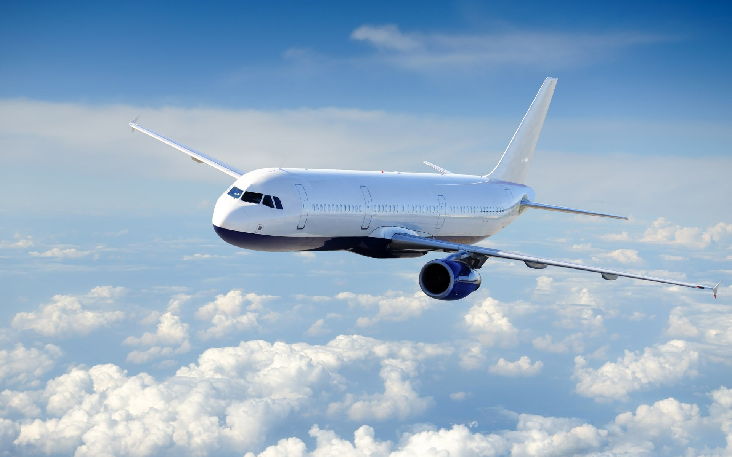
Predicting Flight Delays
Calvin Chua
DAT 9

Slide 2
Predicting Flight Delays
Problem
Onion Travel Agency (OTA) is a new player to the US market and wants to carve a name for themselves by ensuring customers encounter minimal delays. As such, OTA needs to be able to predict flight delays to make the most convenient bookings for their customers. As the end-of-year holiday season is key, OTA’s focus is on the months of November and December.
Project Goal
To predict flight delays through analysis of the various factors causing delays in previous years.
Hypothesis/Assumption
Assumption: Time/day of flight departure/arrival, airport of departure/arrival contribute to delays. (Features are chosen based on this assumption)
Limitations
Data is only true for US airports and domestic flights
Analysis is only true for a specific period (i.e. November/December)
Notes:
Draft a well-formed problem statement relevant to a business problem affecting your team, division, or organization.
Include the following elements: Hypothesis/assumptions
Goals and success metrics
Risks or limitations

Slide 3
Identified Dataset
Sample Data
Publicly available data is taken from the “Bureau of Transportation Statistics” website.
(https://www.transtats.bts.gov/Tables.asp?DB_ID=120)
Data Timeframe:
November/December
Years 2012-2017
Data Shape (Sample):
Rows: 454163
Columns: 31
Features
Travel Period: Month, Day, Time
Airline: Carrier Code, Flight Number, Tail Number
Airport: Origin Airport and City, Destination Airport and City
Departure/Arrival Performance: CRS Time, Actual time
Cancellations: Cancelled, Cancellation Code, Diverted
Cause of Delay: Carrier Delay, Weather Delay, NAS Delay, Security Delay, Late Aircraft Delay
Terms:
CRSDepTime (the local time the plane was scheduled to depart)
CRSArrTime (the local time the plane was scheduled to arrive)
CRSElapsedTime (the scheduled difference between departure and arrival)
NAS Delay: National Air System Delay
Definitions in delay types can be found at: http://aspmhelp.faa.gov/index.php/Types_of_Delay)
Notes:
Include the following elements: Hypothesis/assumptions
Goals and success metrics
Risks or limitations

Slide 4
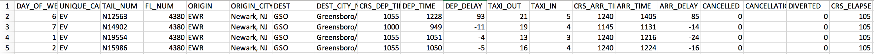
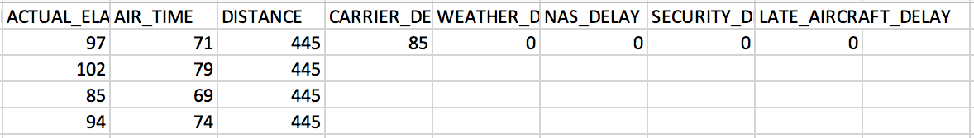
Sample Data
Are delays more common on particular days?
Are delays more common from or to particular cities?
Are delays more common on particular flights or planes?
Are delays more common on particular arrival or departure times?
Are delays due to weather or other causes?

Slide 5
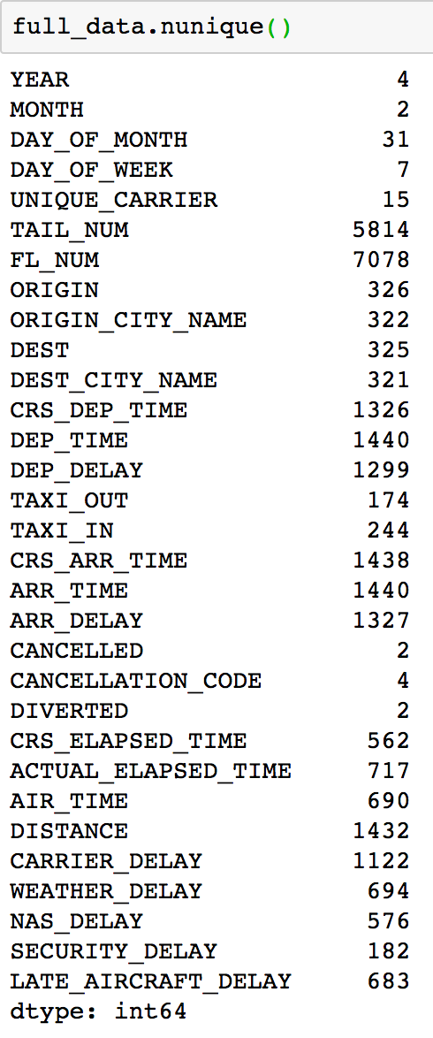
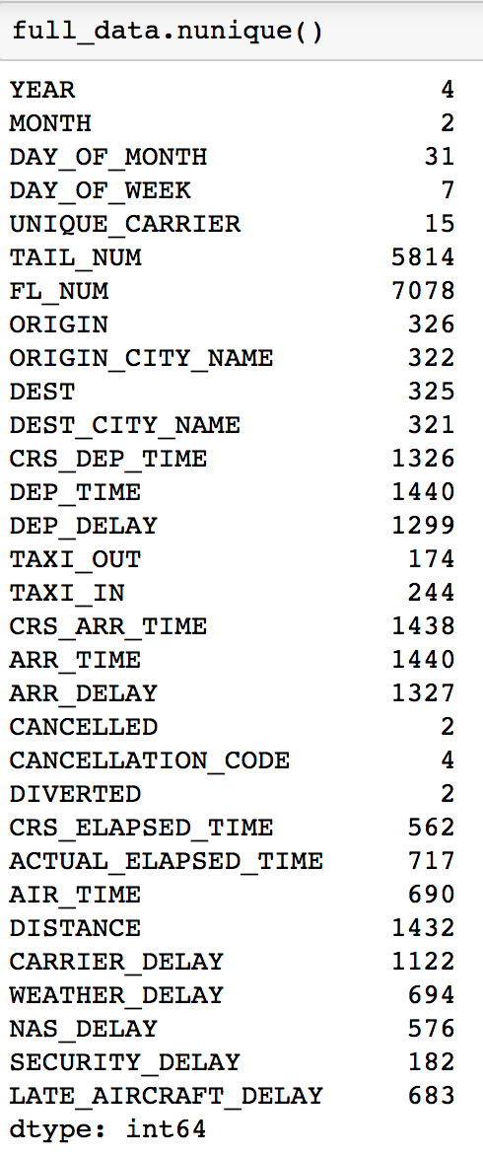
EDA
Is The Data Usable? (Variance in features, Null data)
Is there variance in feature data?
High amount of unique values
Do features have null values?
Most null values: Flight Number (FL_NUM)
0.2% (7078 out of 3716693) null values

Slide 6
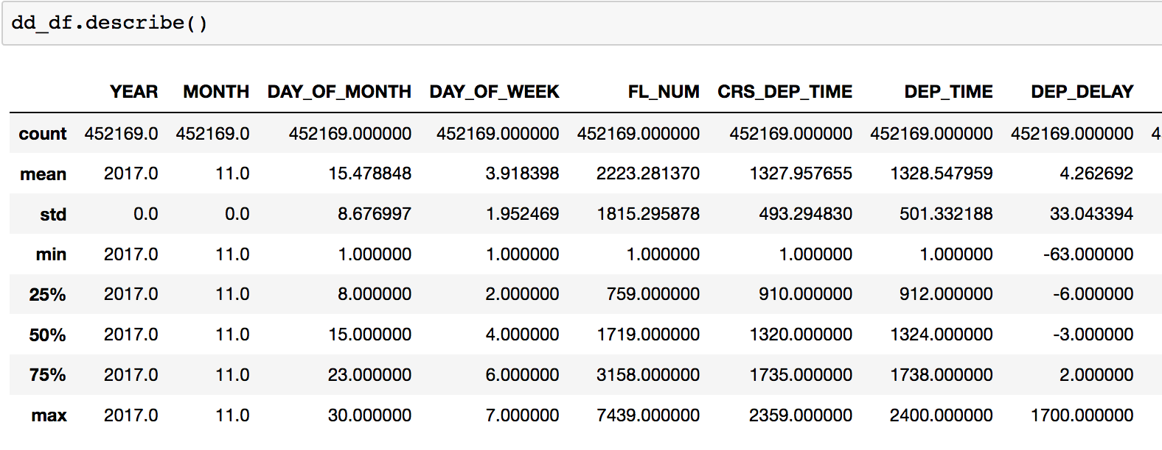
EDA
Key Features,
Features:
Drop features that are not needed.
‘DEP_TIME’, and ‘ARR_TIME’, were removed
Important features: (To find: Which carrier, Which day, Which airport, How much delay)
‘DAY_OF_WEEK/MONTH’, ‘UNIQUE_CARRIER’, ‘ORIGIN’, ‘DEST’, ‘DEP_DELAY’, ‘ARR_DELAY’,
Drop rows with null values in important features
98% of data retained
Brief description of numerical features (Are delay times dropping?)
Average of 8.9 mins for departure delay
Average of 3.3 mins for arrival delay

Slide 7
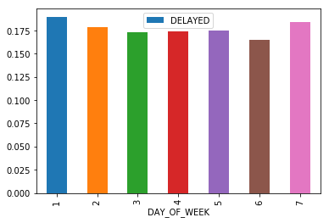
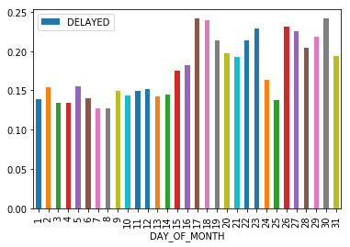
EDA
When Should We Fly?
We should generally choose a flight that is:
In the middle of the week
In the 1st half of the month
Notes:
To merge together AA and US.
While VX, F9 and WN have the highest percentage delay, AA,/OO/NK have the longest delays.

Slide 8
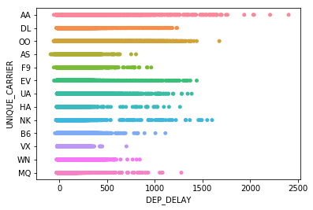
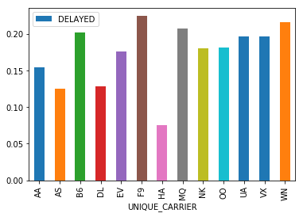
EDA
Which Airlines Should We Take?
Scatter plot of airline vs delay times
F9: Frontier Airlines WN: Southwest Airlines
MQ: American Eagle Airlines B6: JetBlue Airways
FAA considers a flight to be delayed when it is 15 minutes later than its scheduled time
A negative time means that the flight is ahead of schedule
Notes:
To merge together AA and US.
While VX, F9 and WN have the highest percentage delay, AA,/OO/NK have the longest delays.

Slide 9
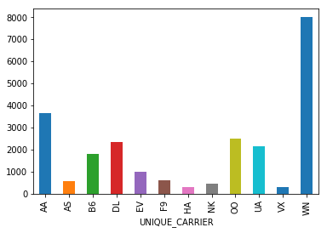
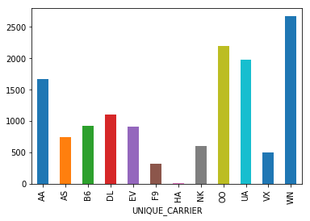
EDA
What kinds of delays are more frequent?
Carrier Code | Carrier | Carrier | Weather | NAS | Security | Late Aircraft | Total
AA | American Airlines Inc. | 3,633 | 104 | 1,663 | 57 | 2,611 | 8,068
AS | Alaska Airlines Inc. | 574 | 115 | 745 | 17 | 628 | 2,079
B6 | JetBlue Airways | 1,792 | 11 | 921 | 30 | 1,398 | 4,152
DL | Delta Air Lines Inc. | 2,328 | 147 | 1,097 | 9 | 1,303 | 4,884
EV | Atlantic Southeast Airlines | 984 | 31 | 910 | 0 | 1,191 | 3,116
F9 | Frontier Airlines | 579 | 9 | 315 | 0 | 619 | 1,522
HA | Hawaiian Airlines Inc. | 293 | 8 | 2 | 1 | 230 | 534
NK | Spirit Air Lines | 458 | 10 | 595 | 17 | 313 | 1,393
OO | Skywest Airlines Inc. | 2,484 | 300 | 2,193 | 16 | 3,857 | 8,850
UA | United Air Lines Inc. | 2,140 | 55 | 1,973 | 0 | 2,140 | 6,308
VX | Virgin America | 298 | 21 | 496 | 15 | 427 | 1,257
WN | Southwest Airlines Co. | 7,979 | 134 | 2,667 | 80 | 8,206 | 19,066
 |  | 23,542 | 945 | 13,577 | 242 | 22,923
No. of carrier delay by airline
No. of NAS delay by airline

Slide 10
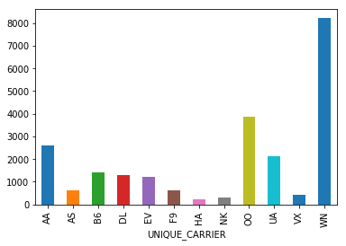
EDA
What kinds of delays are more frequent?
No. of carrier delay by airline
No. of late aircraft delay by airline
No. of NAS delay by airline

Slide 11
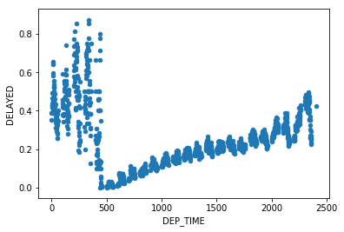
EDA
What Time Should I Fly?
The best departure time seems to be early in the morning to afternoon. Less then 20% of the flights between 4am to 1pm are delayed.

Slide 12
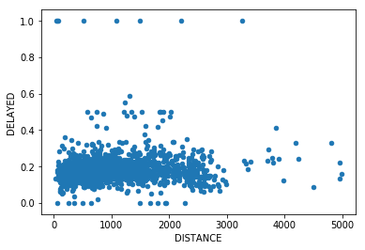
EDA
Which airports are more prone to delays?
Does flight distance matter?
Airports with the most number of delayed flights
ORIGIN | DELAYED | % DELAYED
ORD (O'Hare International Airport) | 36,450 | 20.9%
ATL (Hartsfield-Jackson Atlanta International) | 35,072 | 15.0%
DEN (Denver International Airport) | 30,145 | 21.5%
LAX (Los Angeles International Airport) | 29,711 | 21.7%
DFW (Dallas/Fort Worth International Airport) | 29,309 | 20.6%

Slide 13
What Do the Delays Mean?
Carrier Delay
Carrier delay is within the control of the air carrier. Examples of occurrences that may determine carrier delay are: aircraft cleaning, aircraft damage, awaiting the arrival of connecting passengers or crew, baggage, bird strike, cargo loading, catering, computer, outage-carrier equipment, crew legality (pilot or attendant rest), damage by hazardous goods, engineering inspection, fueling, handling disabled passengers, late crew, lavatory servicing, maintenance, oversales, potable water servicing, removal of unruly passenger, slow boarding or seating, stowing carry-on baggage, weight and balance delays.
Late Arrival Delay
Arrival delay at an airport due to the late arrival of the same aircraft at a previous airport. The ripple effect of an earlier delay at downstream airports is referred to as delay propagation.
NAS Delay
Delay that is within the control of the National Airspace System (NAS) may include: non-extreme weather conditions, airport operations, heavy traffic volume, air traffic control, etc. Delays that occur after Actual Gate Out are usually attributed to the NAS and are also reported through OPSNET.
Security Delay
Security delay is caused by evacuation of a terminal or concourse, re-boarding of aircraft because of security breach, inoperative screening equipment and/or long lines in excess of 29 minutes at screening areas.
Weather Delay
Weather delay is caused by extreme or hazardous weather conditions that are forecasted or manifest themselves on point of departure, enroute, or on point of arrival.
http://aspmhelp.faa.gov/index.php/Types_of_Delay

Slide 14
What Do the Delays Mean?
Air Carrier: The cause of the cancellation or delay was due to circumstances within the airline's control (e.g. maintenance or crew problems, aircraft cleaning, baggage loading, fueling, etc.).
Extreme Weather: Significant meteorological conditions (actual or forecasted) that, in the judgment of the carrier, delays or prevents the operation of a flight such as tornado, blizzard or hurricane.
National Aviation System (NAS): Delays and cancellations attributable to the national aviation system that refer to a broad set of conditions, such as non-extreme weather conditions, airport operations, heavy traffic volume, and air traffic control.
Late-arriving aircraft: A previous flight with same aircraft arrived late, causing the present flight to depart late.
Security: Delays or cancellations caused by evacuation of a terminal or concourse, re-boarding of aircraft because of security breach, inoperative screening equipment and/or long lines in excess of 29 minutes at screening areas.
https://www.bts.gov/topics/airlines-and-airports/understanding-reporting-causes-flight-delays-and-cancellations
Alaska Airlines (AS) Allegiant Air (G4) American Airlines (AA) Delta Air Lines (DL) Endeavor Air (9E) Envoy Air (MQ) ExpressJet Airlines (EV) Frontier Airlines (F9) Hawaiian Airlines (HA) https://www.bts.gov/explore-topics-and-geography/topics/airline-time-performance-and-causes-flight-delays | JetBlue Airways (B6) Mesa Airlines (YV) PSA Airlines (OH) Republic Airlines (YX) SkyWest Airlines (OO) Southwest Airlines (WN) Spirit Airlines (NK) United Airlines (UA) Virgin America (VX)

Slide 15
Moving Forward
To Complete EDA:
Merge all data
Examine missing values
Drop/Fill-in with data
Delete?
Visualization
Airport
Time (hour)
Classification (get dummies)
Next Step:
Need to use “smote-tomek” to balance out the classes (delay/no delay)
Choose the features for learning
Can try:
Decision Trees
Random Forests
Logistic regression (Benchmark for learning??? Good for classification.)

Slide 16
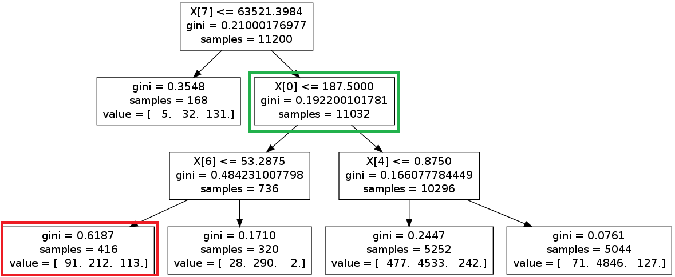
Predictive Modelling
As my problem was a classification problem, I was recommended 3 choices:
Decision Tree:
Took too long to process
Never saw a single tree
Random Forest Classification
Faster processing time compared to Decision Tree
Logistic Regression
Eventual choice
Fastest processing time
Good for people who are prone to mistakes and starting over

Slide 17
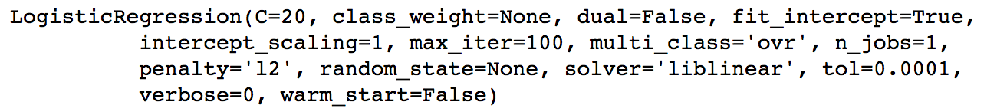
Logistic Regression
Logistic Regression
Had a massive class imbalance (SMOTETomek)
Scaling of features
Modelling
Test size of 50%
Logistic Regression
Accuracy
Confusion Matrix
Classification Report
Area Under Curve

Slide 18
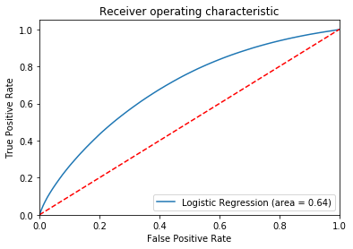
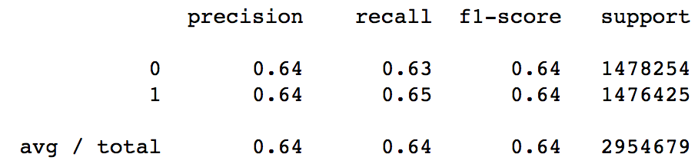
Logistic Regression (Accuracy)
Test 1: Confusion Matrix
Test 3: Area Under Curve
 | predicted
actual |  | Negative | Positive
 | Negative | TN: 931,380 | FP: 546874
 | Positive | FN: 523779 | TP: 952,646
Test 2: Classification Report
All 3 methods of checking gave a similar accuracy of 64%.
Not good -> Pretty Terrible
Could attempt to shift the threshold for Area Under Curve.
Why is it so bad?

Slide 19
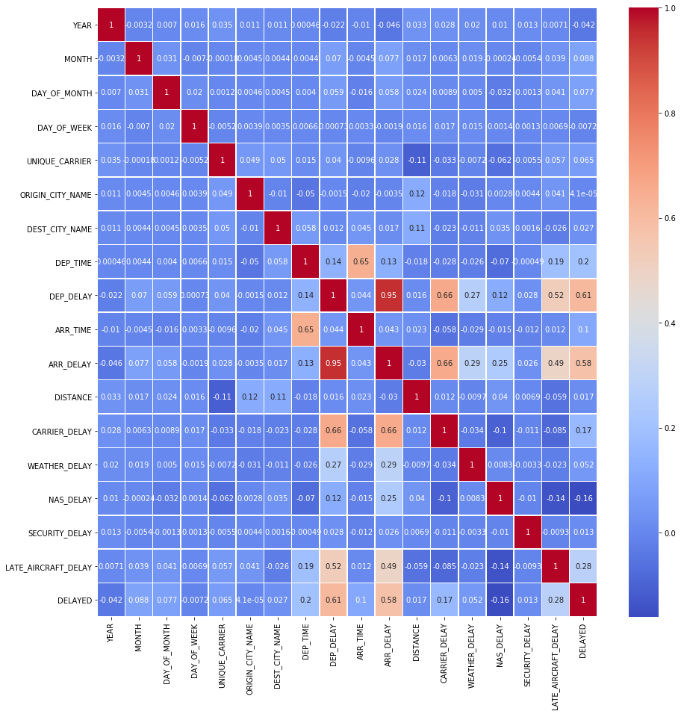
Logistic Regression

Slide 20
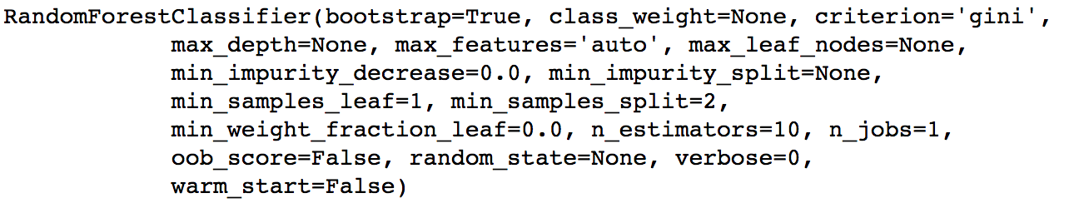
Random Forest Classifier
Logistic Regression
Had a massive class imbalance (SMOTETomek)
Scaling of features
Modelling
Test size of 50%
Logistic Regression
Accuracy
Confusion Matrix
Classification Report
Area Under Curve

Slide 21
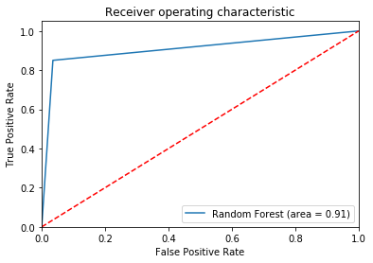
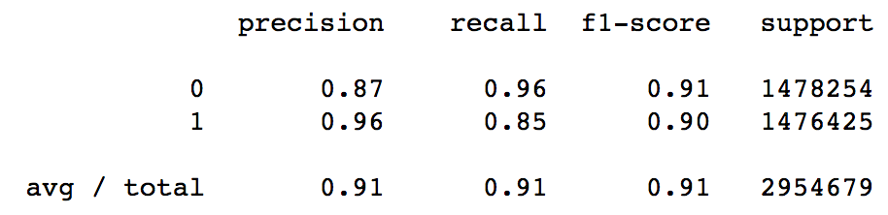
Random Forest Classifier
Test 1: Confusion Matrix
Test 3: Area Under Curve
 | predicted
actual |  | Negative | Positive
 | Negative | TN: 1,426,146 | FP: 52,108
 | Positive | FN: 221,386 | TP: 1,255,039
Test 2: Classification Report
Random Forest Classifier seems to have done well with this dataset.

Slide 22
Closing
This December, take 2 weeks of leave, and fly on the 12th of December.
It’s a Wednesday
1st half of the month
Remember to choose a dataset that shows correlation
While a machine is doing the hard work for us, it still relies on patterns to learn
Learns in a similar way to humans
Do continue working on other projects after this course
Use it or lose it

